Slide 1

Car Price Prediction App

Slide 2
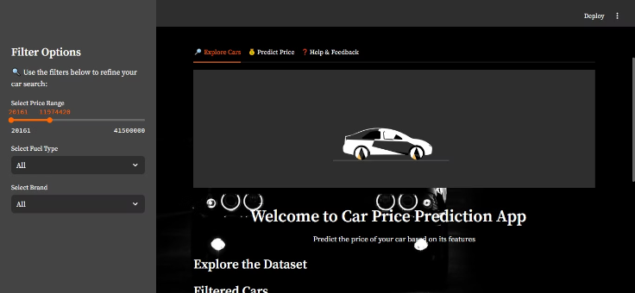
Project Scope
Dataset Details
Deployment
Records: 10,000+ car records.
Streamlit-based app for real-time predictions.
Features: 12+ attributes (Price, Brand, Mileage, Engine Size, etc.).
Null Handling: Fixed missing data across 3 key columns.

Slide 3
Data Handling & Cleaning
1
Missing Value
Handled missing values in 3 features (Mileage, Power, Engine).
2
Outlier Removal
Removed 200+ outlier based on boxplots.
3
Data Scaling & Encoding
Scaled numerical values using StandardScaler.
Encoded 5 categorical features with LabelEncoder.
4
Result
Cleaned dataset with 0 null values.

Slide 4
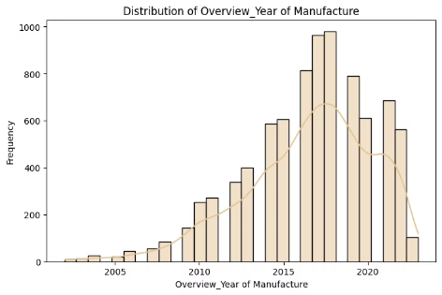
Exploratory Data Analysis (EDA)
1
Correlation Analysis
2
Feature Distribution
3
Scatter Plots
Correlation heatmap to find important predictors.
Distribution plots for key features (Price, Mileage).
Scatter plots (Price vs Mileage, Power, Engine Size).
4
Insights Gained
Price strongly correlates with Engine Size and Power.
Older cars and those with high mileage are priced lower.

Slide 5
Feature Engineering
Feature Addition
Feature Importance Ranking
Created a new feature: Car Age = 2024 - Year of Manufacture.
Feature importance ranking Top Features:
Engine
Simplified Owner categories (First, Second, Multiple Owners).
Power
Mileage
Merged Fuel and Transmission data for better grouping.
Feature Transformation
Final Dataset
One-hot encoded 3 categorical variables (Fuel, Transmission, Brand).
10 critical features for model training.
Aggregated 2 variables into a combined feature (Torque and Engine Power).

Slide 6
Feature Selection
Steps Taken
Description
Correlation Analysis
Identified 5 top features.
Random Forest Importance
Removed 2 irrelevant features (Wheel Size, Torque).
Final Feature Set
Retained 12 key features for model training.

Slide 7




Model Selection
Linear Regression
Baseline (Accuracy: 72%).
Random Forest
Non-linear (Accuracy: 82%).
Gradient Boosting
Best choice (Accuracy: 86%).
Chosen Model
Gradient Boosting
Why? Handles non-linear relationships, minimizes overfitting, and provides robust predictions.

Slide 8



Hyperparameter Tuning
Grid Search
Regularization
Prevention of Overfitting
Optimal parameters for Gradient Boosting.
learning rate: 0.05, max depth: 6.
Limited tree depth to prevent over-complex models.
Early stopping with validation data.

Slide 9
Model Selection & Final Accuracy
1
Accuracy
2
Why 86% Accuracy?
3
Train Accuracy
86% on test dataset.
Balances bias and variance effectively.
87%; consistent with test results.
Prevents overfitting while maintaining generalization.

Slide 10
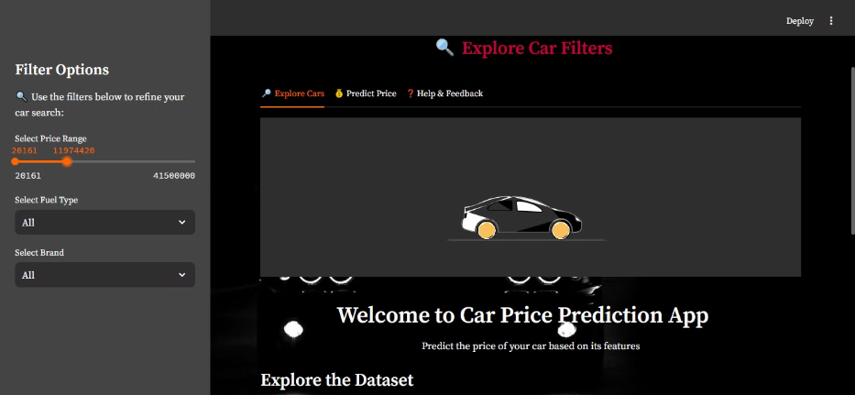
Deployment & User Interaction
10 Input Fields: User can input details like Year, Mileage, Power, etc.
2 Filters: Search by Brand or Price Range.
Visualization: Interactive scatter plots (Price vs Mileage).

